Slide 1
Capstone Project: Automated Testing of Healthcare Website (westfloridaahec.org)
Peyton Davis

Slide 2
Capstone Project: Automated Testing of Healthcare Website
Submitted By: Ayush Shah
Batch: Java Selenium Batch-2
Supervised By: Mrs. Harsha Khande

Slide 3
Agenda
Introduction
About the
application
Objectives
Scope
In Scope
Out Of scope
Testing process
Framework
Sample test cases
Sample reports
Challenges and solutions

Slide 4
About the Application
West Florida AHEC (Area Health Education Center) is a healthcare initiative that provides community-focused healthcare programs, educational training, and outreach resources. Its goal is to improve community health outcomes through prevention, awareness, and access to essential health services.
Key Modules:
Home / Landing Page: Provides a welcoming interface with quick access to healthcare resources, news, and announcements.
Navigation Menu & Search Bar: Helps users easily explore programs, services, and educational materials across the website.
Programs: Includes AHEC Scholars, Tobacco Cessation, Healthy Aging, and Covering Florida (health insurance guidance). Each program page provides details, resources, and contact information.
Services: Offers information on community health events, workshops, and support services.
Contact Us: Includes forms for inquiries, feedback, and community outreach requests.
My Account (Registration/Login): Allows users to register for accounts, manage profiles, and access personalized resources.

Slide 5
Objectives
Ensure functionality & reliability – Validate navigation, forms, and health programs for a smooth user experience.
Automate core UI tests – Reduce manual regression effort, save time, and minimize human errors.
Continuous validation with Jenkins – Run automated tests on every build for early defect detection.
Clear test reports & traceability – Provide detailed reports (Extent/Cucumber) linked with Jira for issue tracking.
Improve collaboration with BDD – Use Cucumber scenarios to align developers, testers, and stakeholders.

Slide 6
Automated Testing of Healthcare Website

Slide 7
Scope
Automated UI tests (Selenium) – Cover critical user flows to ensure functionality across key modules.
Manual testing (Jira/Zephyr) – Perform exploratory testing and capture edge cases that automation may miss.
BDD with Cucumber – Define expected behavior in Gherkin for better collaboration and clarity.
CI/CD integration – Run automated tests in Jenkins pipelines with cross-browser validation.
Reporting & traceability – Generate detailed reports (Extent/Cucumber) with defect links in Jira.
Scalability – Framework designed for future expansion (mobile, API, and performance testing).

Slide 8
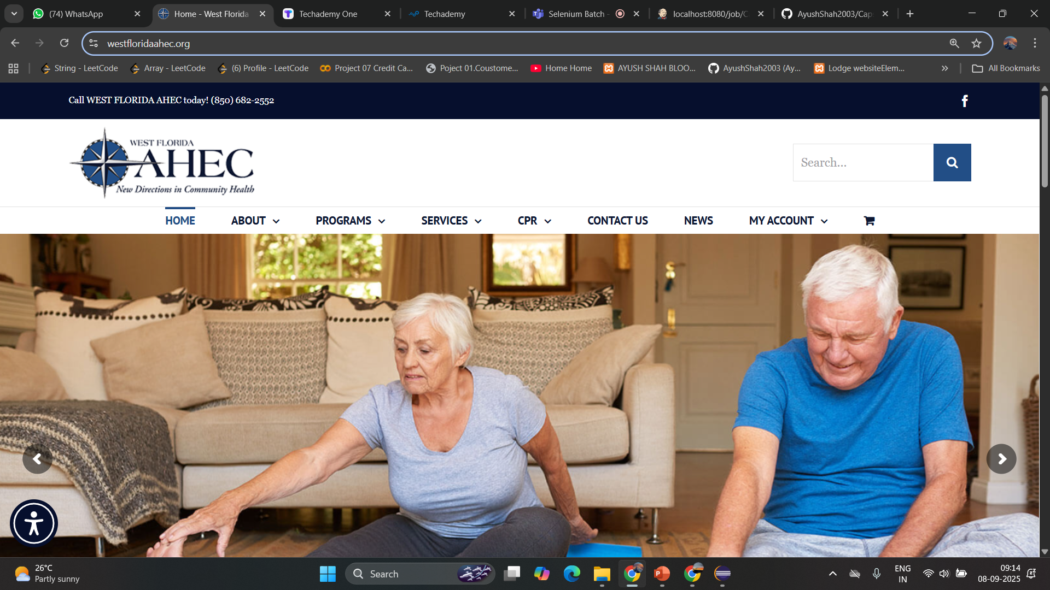
In Scope
Home page: navigation, search, and resource links.
Program detail pages: content verification and related resources.
Contact Us form: field validation and submission.
User account: registration, login (CAPTCHA handled manually), and basic profile actions.
Cross-browser checks: Chrome, Firefox, Edge.

Slide 9
Testing Process
Requirement Analysis – Understand functional and non-functional needs.
Test Planning – Define scope, resources, schedule, and tools.
Test Design – Create test cases (manual & automated) and BDD feature files.
Test Development – Implement Selenium scripts, page objects, and step definitions.
Test Execution – Run tests (local/CI), log results, capture screenshots on failure.
Reporting & Defect Management – Generate reports and file issues in Jira/Zephyr.

Slide 10

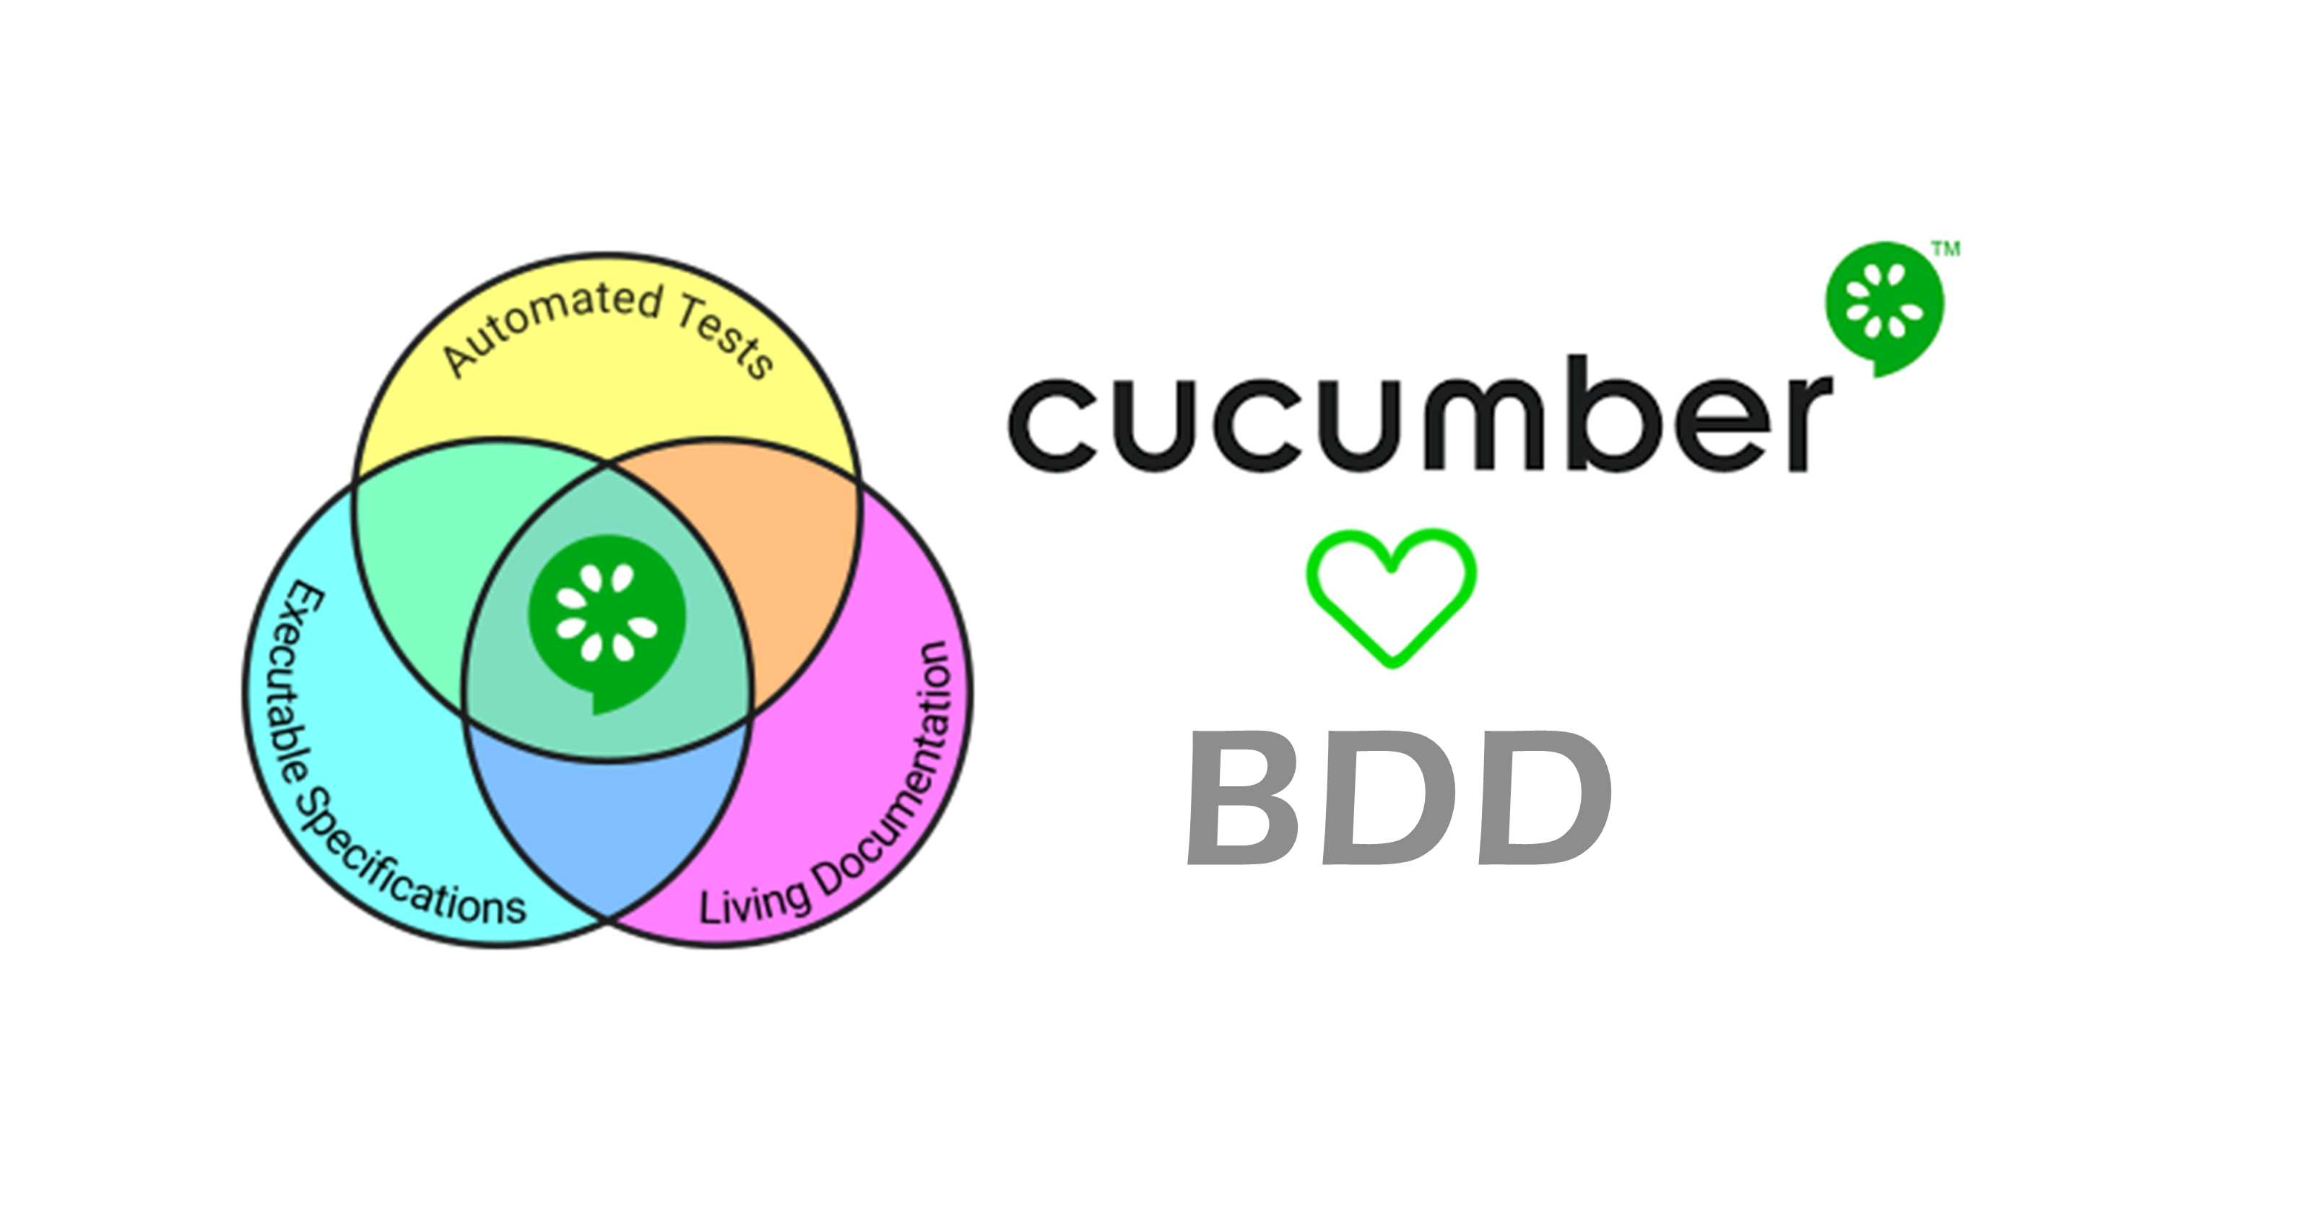
Framework
Architecture: Page Object Model (POM) for maintainability and reusability.
Automation engine: Selenium WebDriver + TestNG (or JUnit).
Build & dependency management: Maven.
BDD: Cucumber (Gherkin feature files) + step definitions.
CI/CD: Jenkins pipeline to execute automated suites on every build.
Reporting: Extent Reports for HTML test reports; Cucumber reports for feature-level visibility.

Slide 11
Sample Test Cases
Home Page: Verify navigation menu, search bar, featured programs, and resource links.
Programs: Navigate to program pages (AHEC Scholars, Tobacco, Healthy Aging) and validate content & resources.
Contact Us: Validate form fields, required validations, and successful submission flow.
User Registration & Login: Create test accounts, login, logout, and password recovery flows (if available).
Cross-Browser: Run the above test cases across Chrome, Firefox, and Edge.

Slide 12
Sample Reports
Extent Reports: Execution summary, pass/fail breakdown, screenshots on failure, and test-level details.
Cucumber Reports: Feature/scenario level status, step details, and embedded screenshots.
Jira/Zephyr: Link tests to requirements, log defects with steps to reproduce and attach evidence.

Slide 13
Sample Reports
Extent Reports: Execution summary, pass/fail breakdown, screenshots on failure, and test-level details.
Cucumber Reports: Feature/scenario level status, step details, and embedded screenshots.
Jira/Zephyr: Link tests to requirements, log defects with steps to reproduce and attach evidence.

Slide 14
Challenges and Solutions
Flaky locators & dynamic elements: Use robust locators (CSS/xpath), normalize-space(), and relative paths.
CAPTCHA blocking automation: Exclude CAPTCHA from automation; handle via manual step or test APIs/test accounts.
Cross-browser inconsistencies: Use WebDriverManager and targeted cross-browser test suites in CI.
Synchronization/timing issues: Prefer explicit waits (WebDriverWait), retry logic, and stable test environments.

Slide 15
Thank you
Ayush Shah
424.555.0124 | 11ayushshah@gmail.com

